Slide 1



Employee Attrition
By: TEAM DELTA (MACHINE LEARNING)

Slide 2


Overview
Introduction
01
About ITSOLERA
02
Methodology
03
Useful Insights
04
Model Used
05
Appendex
06

Slide 3

Introduction
The @company are facing the issue of sudden act of employees resignation. So , for this purpose they have contacted @ITSOLERA which is a IT software house to find out what is the exact reason behind this thing. They want to retain their employees . They expects some useful insights and best model from the @ITSOLERA team which will help them to find out who will leave or why will he leave and do some precautionary or productive measures to stop the employees.

Slide 4

About us
ITSOLERA is dedicated to leading the way in IT services. We specialize in a diverse range of areas, including Cybersecurity, Artificial Intelligence, Cloud Computing, Blockchain, Networking, Digital Marketing, Graphic Design, Application and Web Development and other IT related services. Our goal is to provide tailored solutions that meet the dynamic needs of our clients.
Our Mission
To be the preeminent catalyst of digital transformation, pioneering innovation and empowerment in the global IT landscape.
At ITSOLERA, we are committed to orchestrating unparalleled technological advancement and knowledge dissemination. Through our cutting-edge solutions and comprehensive training initiatives, we strive to empower businesses and individuals alike, fostering growth, resilience, and prosperity in the digital era

Slide 5

Methodology
For Solving the problem, we use the Machine Learning methodology which starts from the data collection and it ends with the executive report. During those phases,we cleans,preprocess and modelling the data for the future predictions.. The following is the complete methodology used to solve the employee attrition problem:
Data Collection
Clean & Preprocess
EDA
Data in the csv form have been taken from the stack-holders of the company. This data contains more than 73 thousand rows and 24 columns which includes job , age and gender etc.
After that data have been cleaned from the outliers and null vlues. Apart from this , some type of encoding is also used to encode the data from the string format into numerical form which is a need of ML Algorithm.
Exploratory Data Analysis have been done in a detailed way to get the useful insights and find out the way of why the employees left the company. So,in that phase,EDA had been done with the help of pandas and seborn

Slide 6
Methodology Contd....
Feature Engineering
Model Train and Evaluation
Executive Report
Feature Engineering and Feature selection have been done to select and make those new features which impact our model and make it good with high accuracy and better Prediction.
In this step, We used GridSearchCV to find the best model for our data. On that process, we find out fla model which gives us the fla accuracy.We also evaluate and deploy this on streamlit app.
At the end, we prepared an executive report which includes the solution of this problem. This includes the algorithm info used in this project.

Slide 7
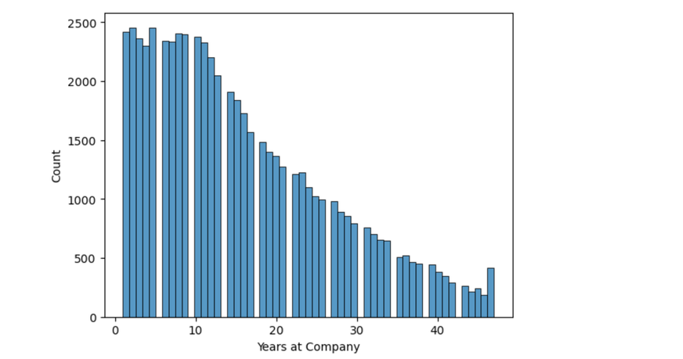
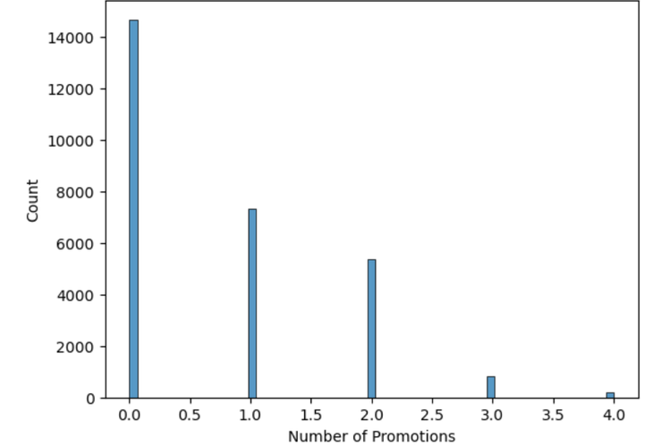
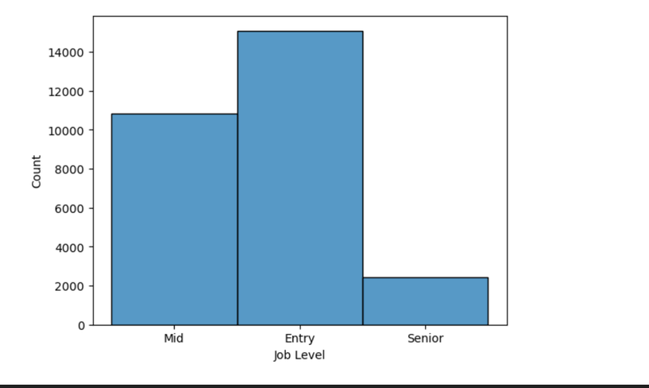
Useful Insights
Years spend by Employees at Company
Promotion ratio of Employees who left
Job level ratio of Employees who left
This histogram shows the people who left after spend years at company. And you will notice that whenever the years increases, the leaving ration decreases.
It has been clearly seen, the people who are promoted less time are likely to leave the company.
This graph shows that mostly those people left who are entry level or mid level.

Slide 8
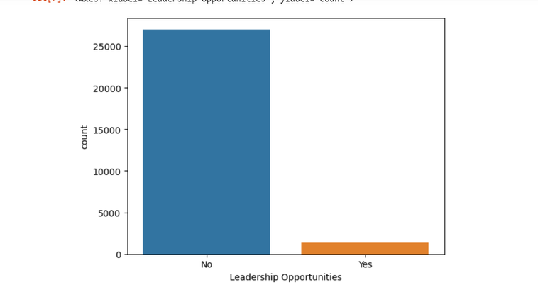
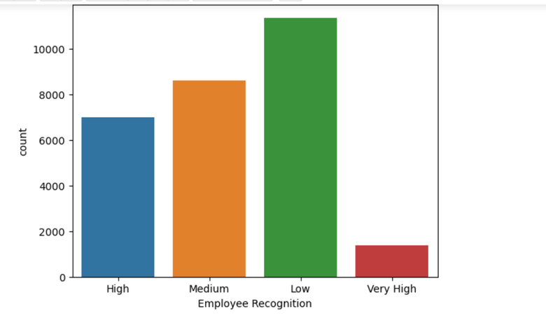
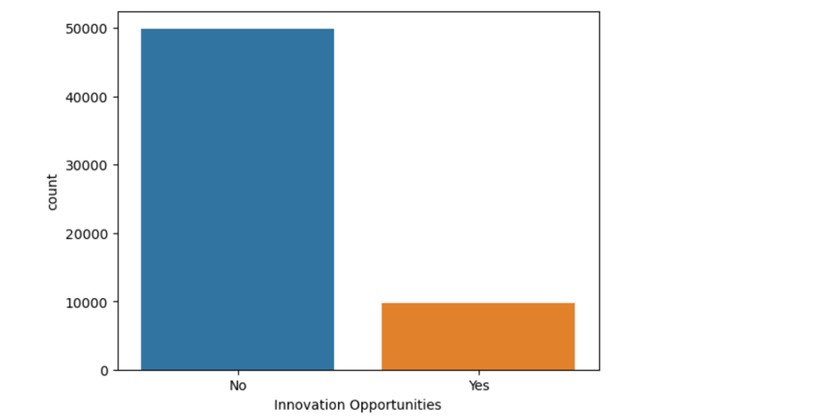
Useful Insights
Employees left due to low recognized
Employees left due to lack of Leadership opportunities
Employees left due to lack Innovative Opportunities
Employees who are low recognized have the high probibility of being left out
It has been clearly seen, the people who are promoted less time are likely to leave the company.
This graph shows that mostly those people left due to the lack of Innovative opportunities.

Slide 9
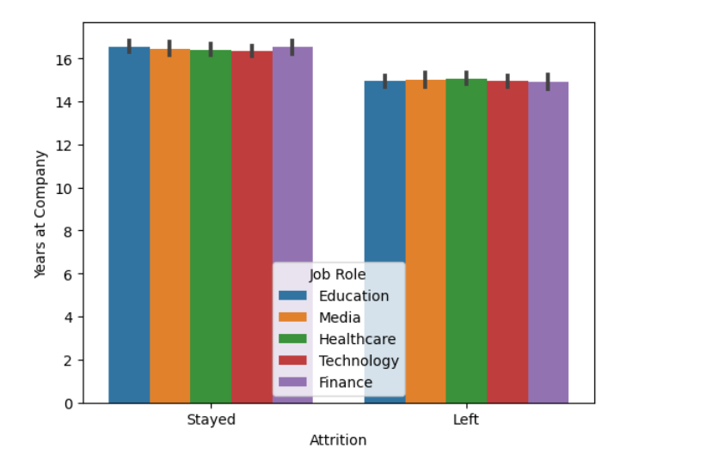
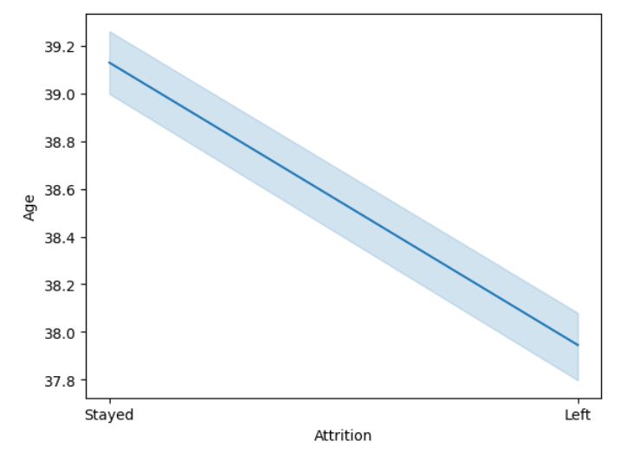
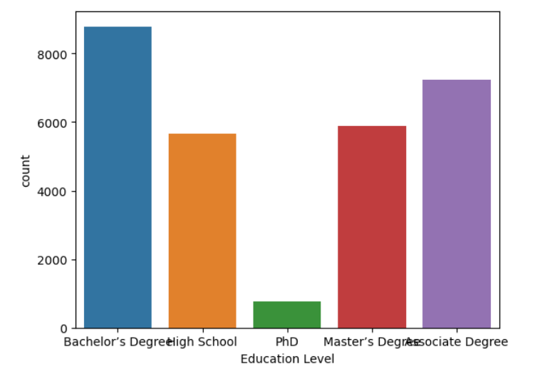
Useful Insights
Bar Graph of Employees from diff Dept
Line plot of Age vs Attrition
Qualification of Employees who left
This clearly says that the people who left the company are mostly from Technology department
It has been seen that whenever there is a increase in the Age, the possibility of staying in the company increases.
This graph shows whenever there is a increase in the qualification, the ratio of leaving decreases.

Slide 10
Useful Measures
Employees in the company must be recognized.
The number of promotions must be increased for the talented employees.
The ratio of leadership opportunities must be increased for the people or employees who are talented.
The same you have to do for innovation opportunities.
The employees who have joined as new should be encouraged and they should be given proper opportunities. Due to this, they will see their future in your organization and will be there for a long period.

Slide 11
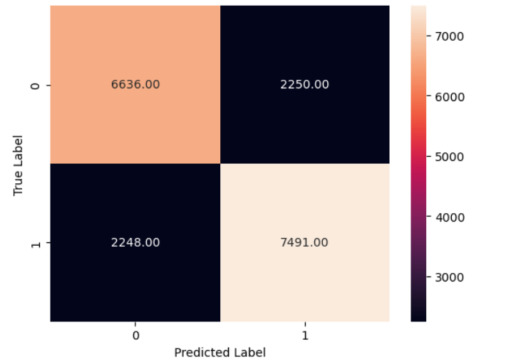
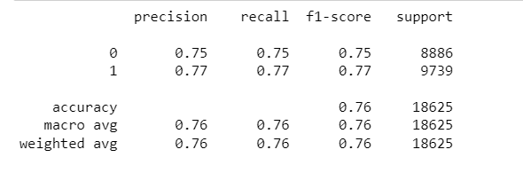
Model Used
For Solving the problem, we have checked almost every classification model such as KNN, Random Forest, Decision Tress, Gradient Boost, AdaBoost, LightBGM, SVM. We have used these models with Minmax scaler and without any scaler. We have also added some more data in order to improve its accuracy. From all these models, Adaboost have given us a better accuracy. At first time , it was round about 70 but with Hyperparameter tuning it reached towards 76..
Confusion Matrix
Classification Report

Slide 12
Appendix
Libraries used in this project are numpy pandas matplotlib,seaborn,sklearn and lightbgm.
Dataset have been taken from the following link:-
https://www.kaggle.com/datasets/stealthtechnologies/employee-attrition-dataset
The github repository for this project is:-
https://github.com/ayazulhaqyousafzai/Employee_Attrition_End_to_End_Project.git

